Slide 1
Tech Interview Prep:
Approximate Nearest Neighbor (ANN) Mechanics & Strategic Chunking Architecture
“How does an approximate nearest neighbor (ANN) search work, and how do you choose optimal chunk sizes for technical versus narrative documentation?”
1) The Mathematical & Algorithmic Mechanics of ANN (HNSW & IVF-PQ)
2) The Recall-Latency-Memory Trade-off Frontier
3) Strategic Chunking Architectures: Technical APIs vs. Narrative Prose
4) Advanced Production Patterns (Parent-Child & Contextual Ingestion)
Name: Dara Sen
Class: AD331 (Artificial Intelligence)

Slide 2
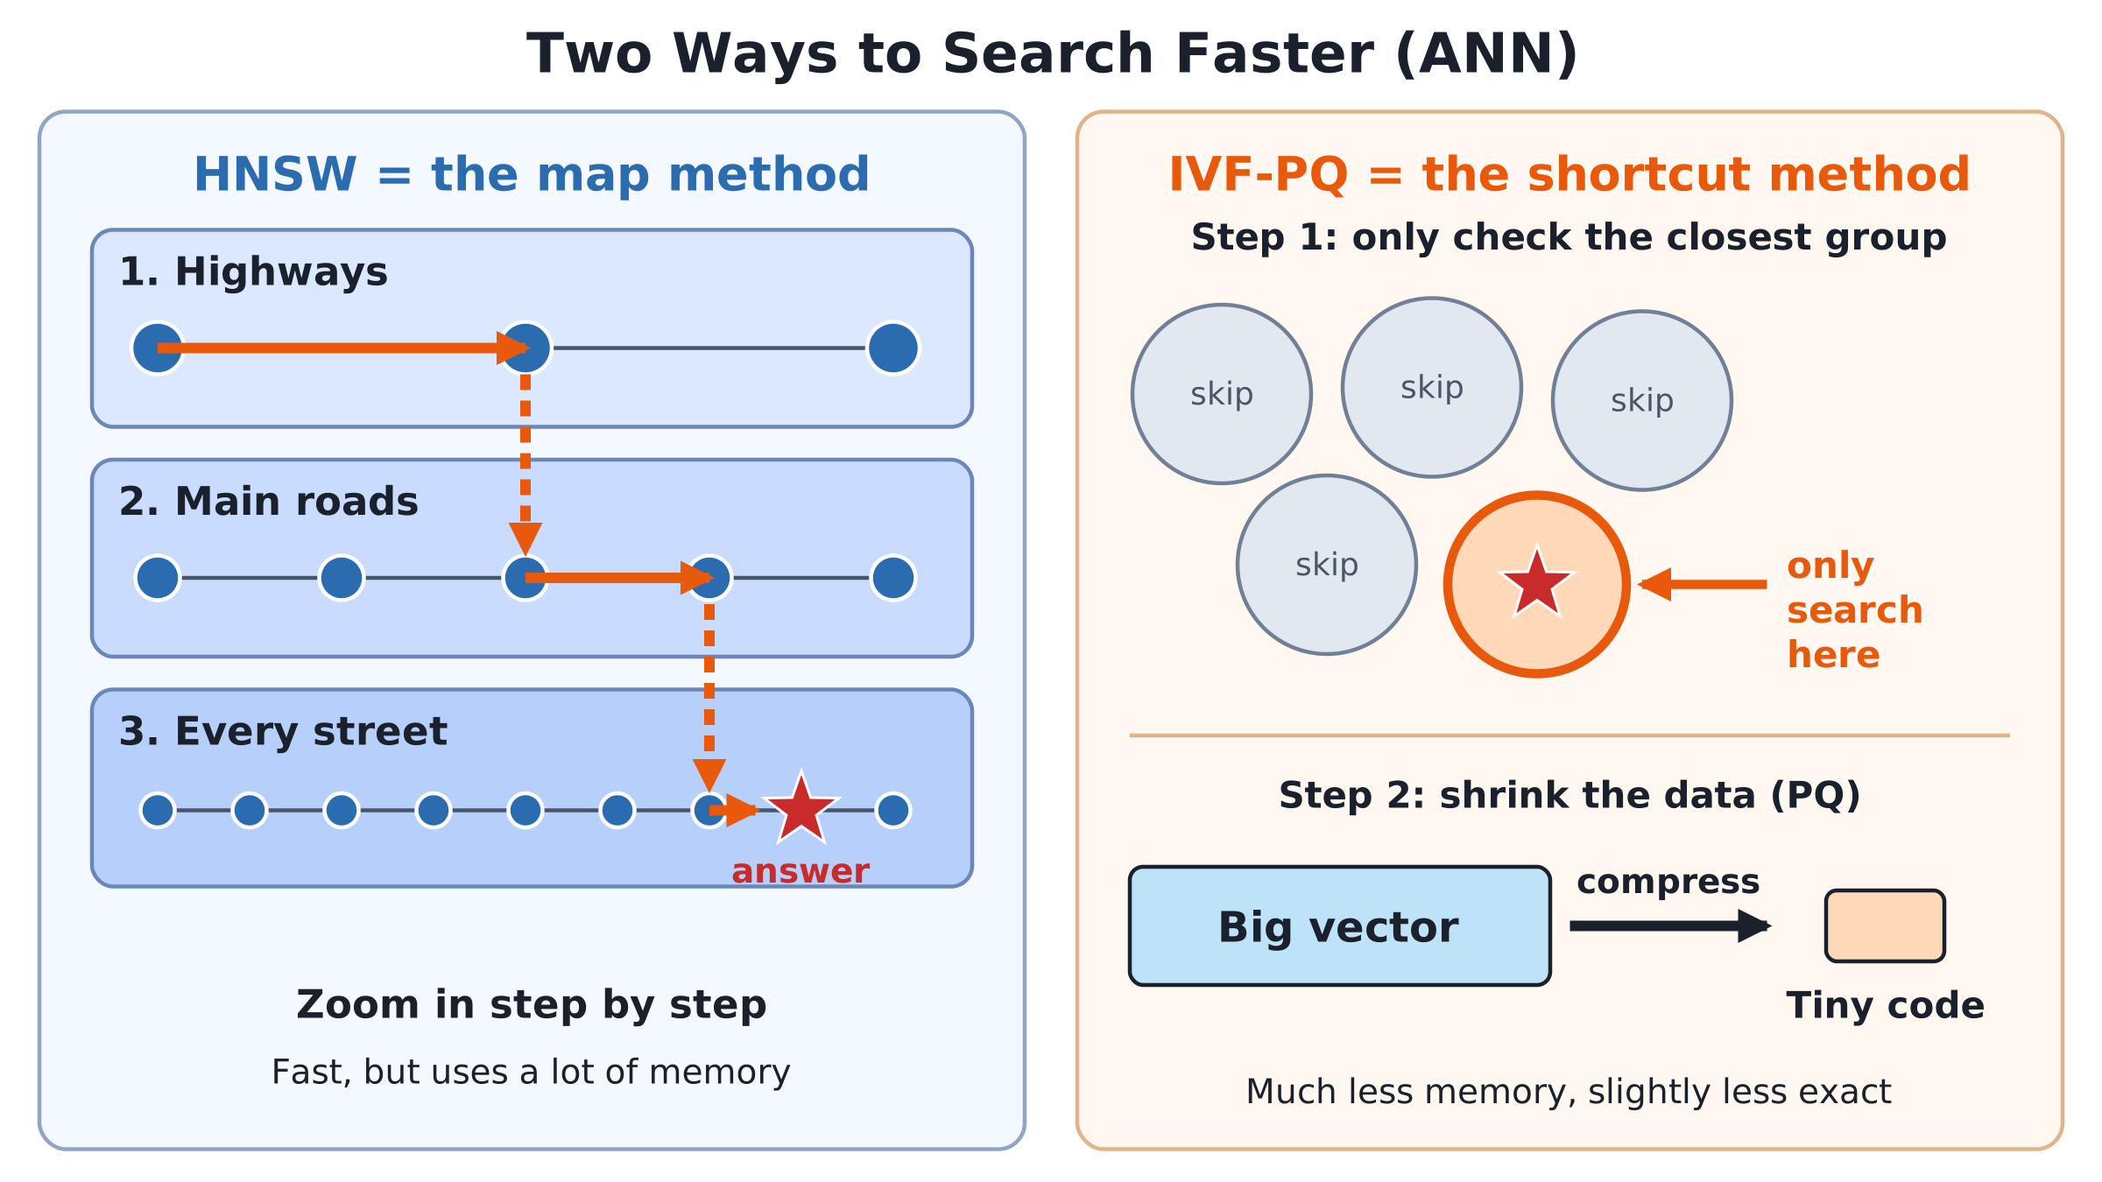
ANN Search Mechanics (HNSW vs. IVF-PQ)

Slide 3
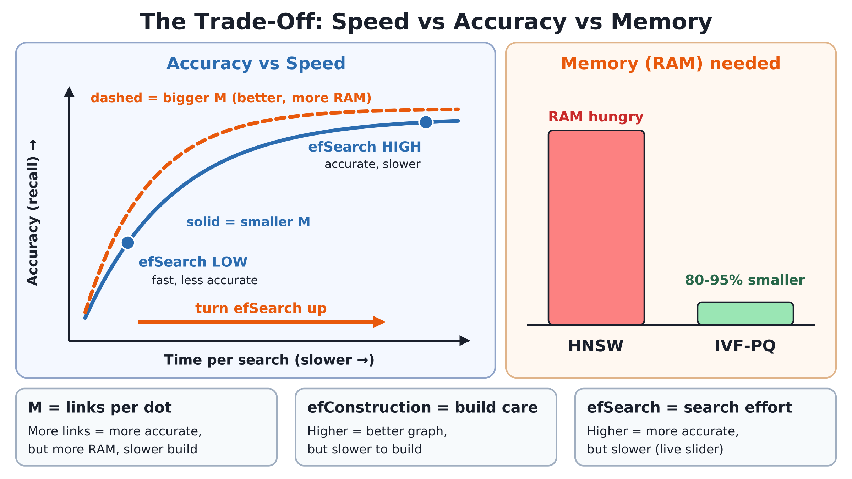
The Production Trade-Off Frontier: Memory, Recall & Tuning

Slide 4
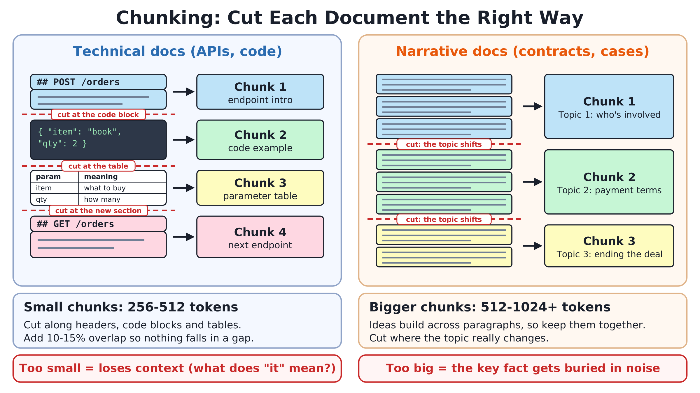
Strategic Chunking: Technical vs. Narrative Documentation

Slide 5
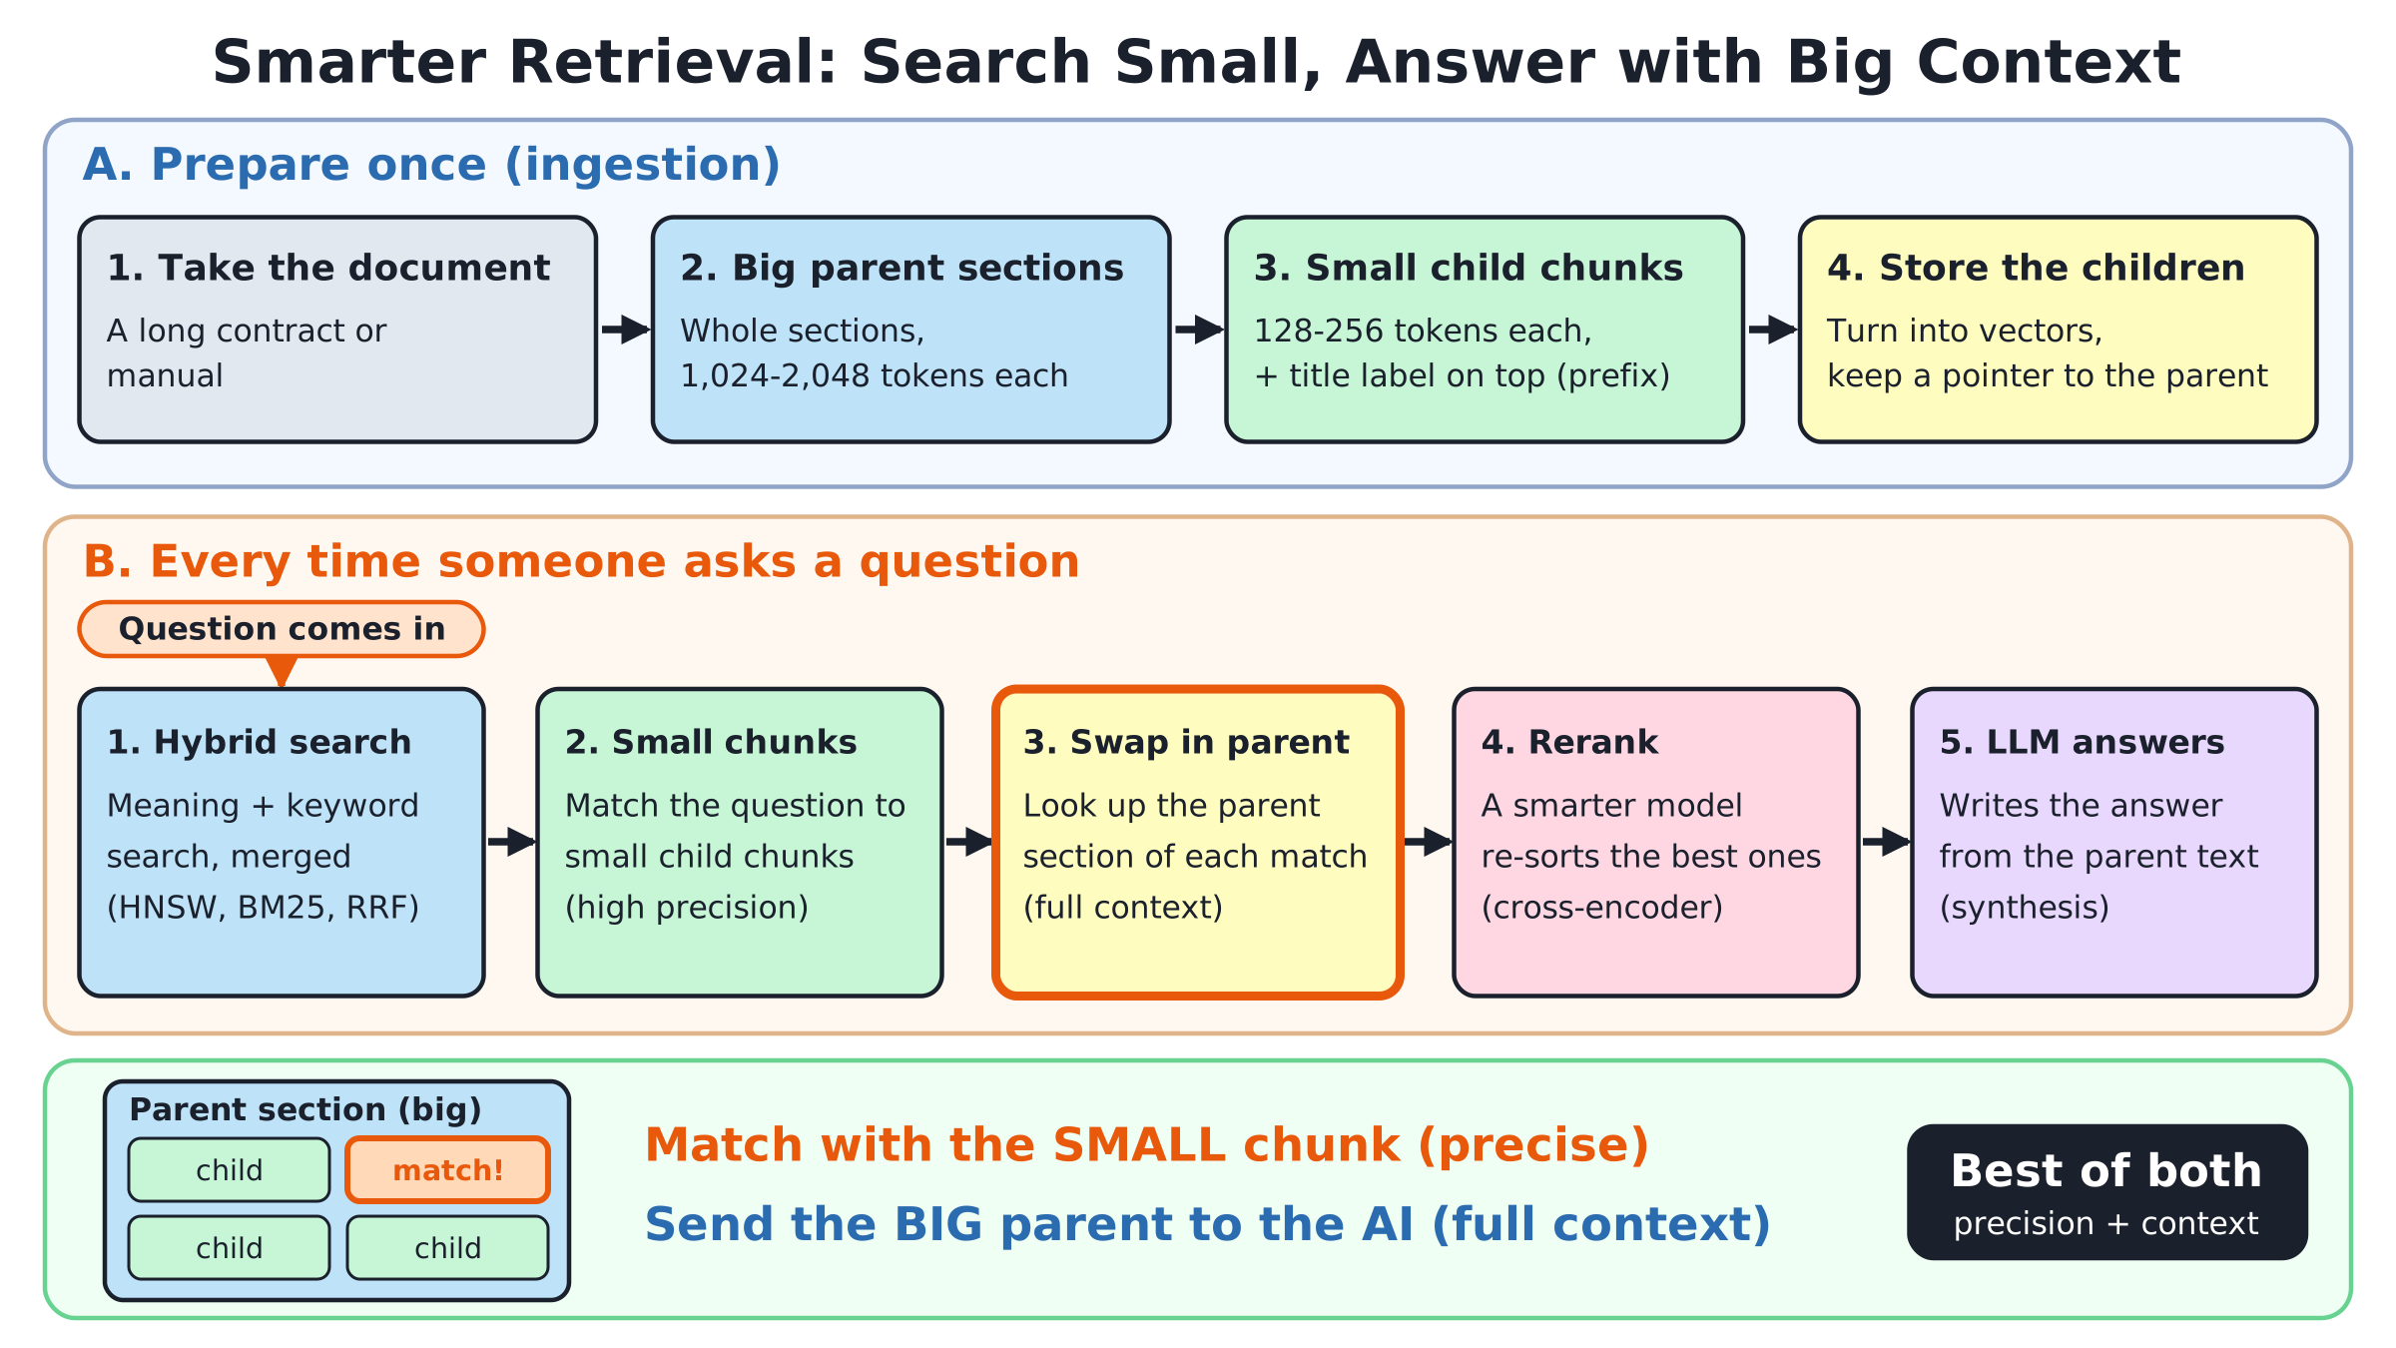
Advanced Mitigations: Decoupling Retrieval from Context

Slide 6
Summary & Systems Architecture Takeaways
Understand the trade-off: speed vs. accuracy vs. memory
Cut documents based on types of documents
Search with small pieces but answer with big ones

